Slide 1
Organized Crime, Violations of Human Rights, & the Neo-liberal Order
.
Notes:
How did we get here? I’d like to explain some important parts of the story for the Mexico case.
The rise of Neoliberal policies has led to the deterioration of the Mexican fabric.
-human trafficking is a poverty related issue. People who were once vulnerable are now crippled.s

Slide 2
Agenda
http://www.youtube.com/watch?v=_M_vhPLAkoA
The Rise of Neo-liberalism
The Rise of Organized Crime in Mexico
9/11 Impact on US Border Security
Calderón’s War on Drugs and Policies
Corruption, Military, Human Rights Violations
The Massacre of Tamaulipas (Case Study)
Trends in Human Trafficking & The Involvement of Drug Cartels

Slide 3
Neo-liberalism
Neo-liberalism in its international usage refers to a political economic philosophy that rejects government intervention in the market. The philosophy specifically emphasizes free market principals and the opening of foreign markets by political means. Neo-liberals argue that markets free of government influence are essential for sustaining economic prosperity. (Beeson & Islam 2005, 199)
Notes:
1) let’s look at the text book definition of neo-liberalism
The basic rules: liberalize trade and finance, let markets set prices, end inflation, and privatize.

Slide 4
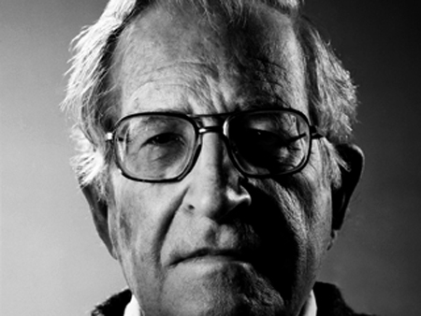
Neo-imperialism
“The government should “get out of the way”---hence the population too, insofar as the government is democratic, though the conclusion remains implicit. The decisions of those who impose the “consensus” naturally have a major impact on global order. Some analysts take a much stronger position. The international business press has referred to these institutions as the core of a “de facto world government” of a “new imperial age.”
-Noam Chomsky on neo-liberal ideology
Notes:
-this is a more transparent explanation
Emphasize the diminished role of the state and the opening up 4 Capital ---→ Mex. Is the poster-child for such reforms
Market Deregulation/ state decentralization/ and reduced state intervention in general

Slide 5
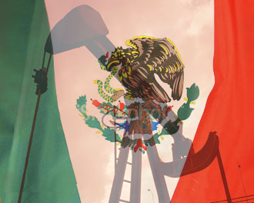
The Roots of the Economic Crisis
President López Portillo – 1970s
4th largest exporter of Oil
Unemployment at 4%
Mexico thriving, but…
Oil price plunge hits Mexico hard
High interest rates on Foreign debt leads to…
Notes:
-During the 70s the economy was doing well, this was due to oil revenue. Mexico was the 4th largest…

Slide 6
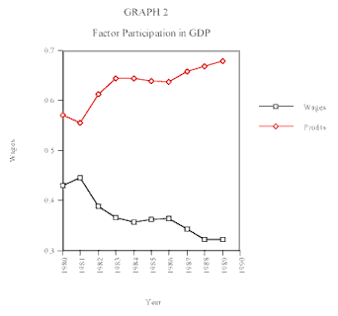
Financial Crisis & the 80s
President Miguel De la Madrid Hurtado -1982
“The Lost Development Decade”
1983 = 12.9%
1986 = 20.3%
53% decrease in real hourly wage
1986 Mexico Enters GATT
Widespread Privatization of State Industries
Property Rights granted to Foreign Investors
Notes:
-worst economic crisis/ opens doors to neo-liberal reforms
Obvious conclusion from graph: Rich have more and the poor less… (GDP vs. wages)

Slide 7
NAFTA - 1994
NAFTA is about FDI
NAFTA tied Mexico’s Development to The United States, with an estimate of 65%-80% of FDI
90% of FDI goes toward exploiting Maquiladora industry (Cheap labor!!)
Notes:
At the Table- pushed through by elites. For our purposes, I’d like to focus on… What were the attitudes by elites toward the agriculture sector? -Agriculture chosen---- Let’s take a look at what happened next------→
Key thing to understand: government abandoned all protections over the agricultural sector

Slide 8
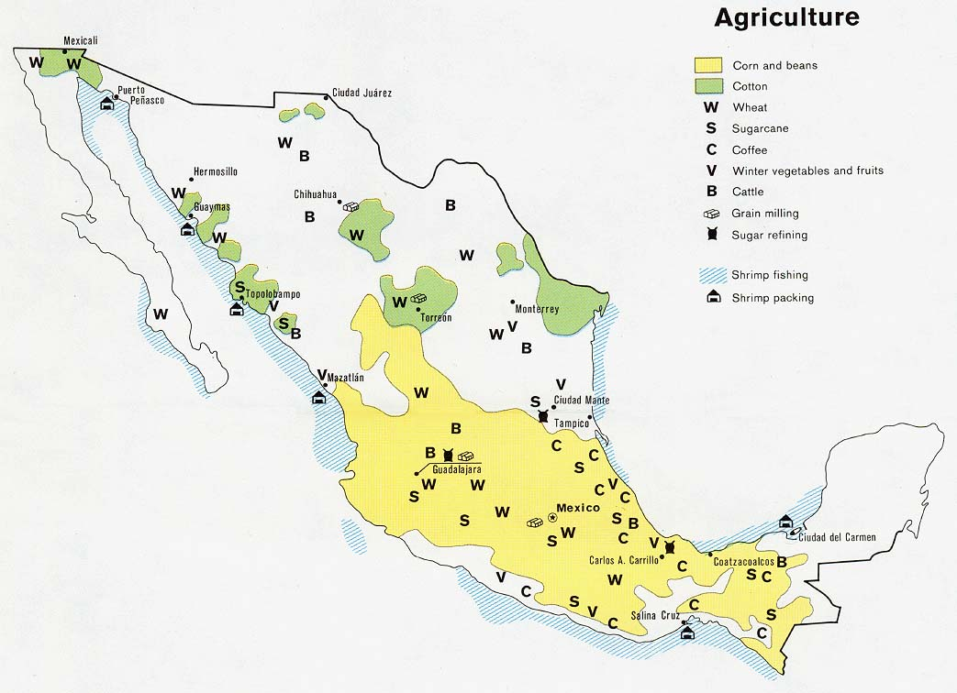
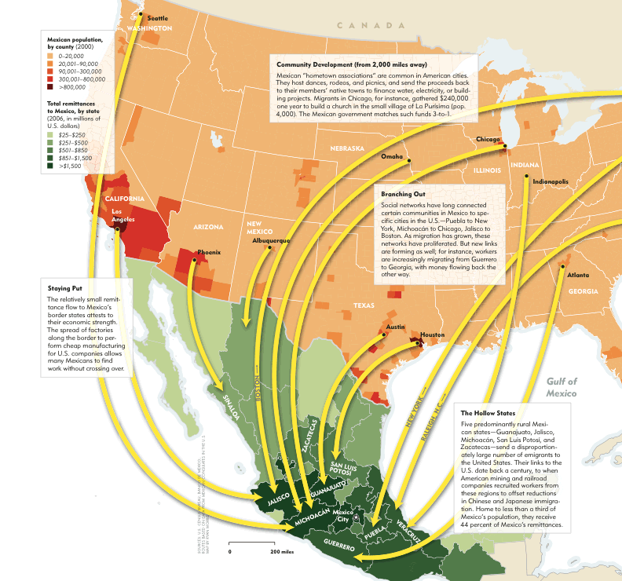
Agricultural Migration
With the entrance of heavily subsidized corn into Mexico,
the agricultural sector was abandoned by the Mexican government
Notes:
Aprox. 11- 12 million rural Mexican displaced
-Tanilee will continue the story

Slide 9
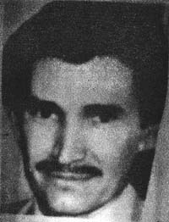
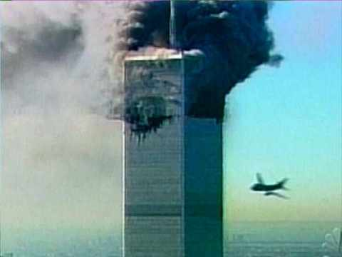
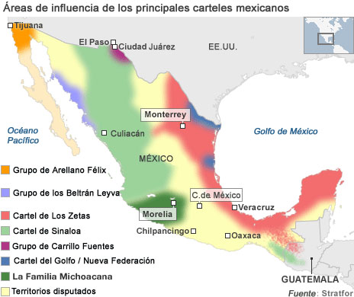
Economic & Political Factors
Unemployment
Rise in Organized Crime
9/11 impact on US Border Security
US Sovereignty
Increase Security
Higher Risk
Lucrative Model
Internal Sales
War on Drugs

Slide 10
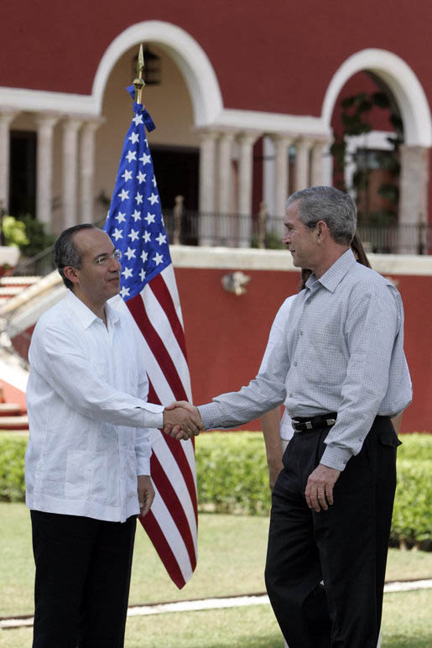
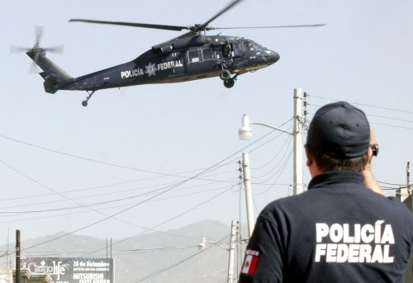
Calderon’s War on Drugs
Merida Initiative
Signed 2008 1.6 Billion
Fight drug trafficking, transnational organized crime and money laundering
Training, equipment , intelligence, judicial reform, building institutions, human rights
Reports to US Congress on Human Rights: to improve police transparency & accountability & ensure investigations of human rights abuses committed by federal policy & the military

Slide 11
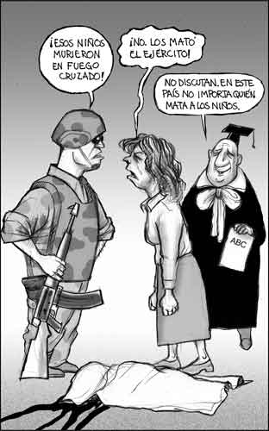
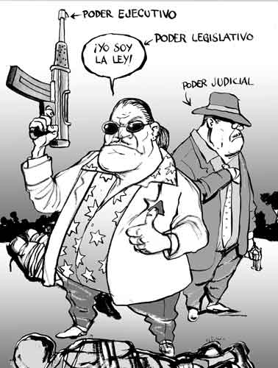
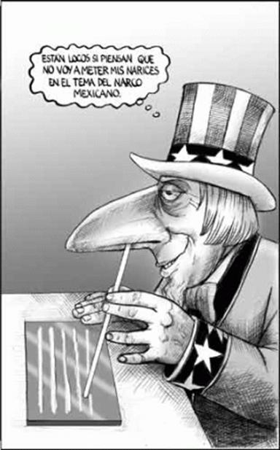
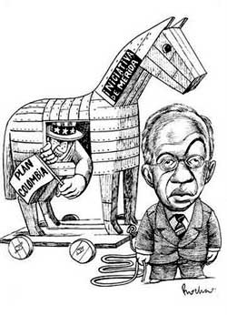
Calderon’s War on Drugs
Merida Policy Critique
Root Cause, Plan Colombia
Lacks sufficient legal reform (Trafficking is a Federal Crime)
Increase in human rights abuses
Corruption within military systems
Human Rights Reports
threat to Mexican Sovereignty
violations would be charged “in accordance to Mexican and International Law”

Slide 12
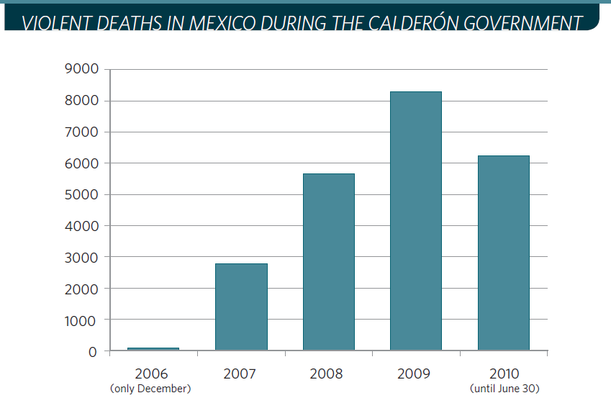
Calderon’s War on Drugs
Merida Policy Critique: Human Rights
Illegal searches, misconduct including rape & torture
No framework to prevent coerced confessions, often through torture
“3 years of Calderon's six-year term, the army has had 153 clashes with drug gangs. 6 years of his predecessor, only 16“
1200 children have been murdered since the war on drugs in 2006
Gruesome acts by cartels sending political messages
No indications of reduction in U.S. market to justify heightened violence
Notes:
Include table/ Chart? As visual?

Slide 13
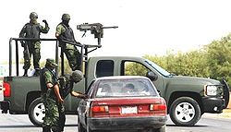
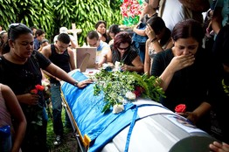
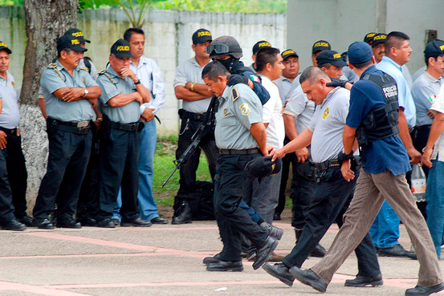
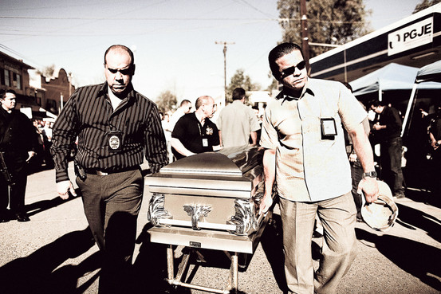
Corruption
Police lay offs
Police versus Military training
Colluding & impact on Human Rights
Accountability to civilian institutions
2000, National Human Rights Commission (CNDH) 2,966 complaints against military , 983 in military-dominated counter-drug operations
2000-2008 military committed 6,874 violations against civilians
Federal government recognized it’s necessary to withdraw the military; it endangers public liberties & human rights
Security threat Mexico’s Sovereignty
Border States

Slide 14
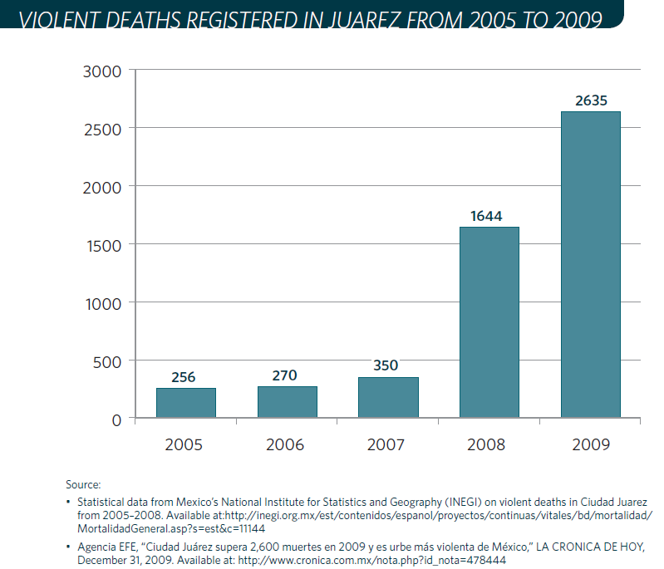
Military & Human Rights, Juarez
Sexual assault & rape of dozens of female detainees in San Sanvador, Atenco
Fear to report
Ciudad Juarez unprecedented human rights violations & murders of women
Females target for Cartels & Military

Slide 15
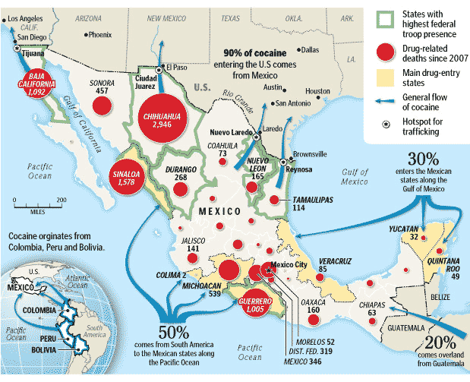
Human Rights Violations
International Recognition: Journalists, Politicians, Civilians
12 mayors murdered in 2010
Mexico has not complied with international or regional human rights bodies
Legal reforms have not been made to ensure respect for human rights

Slide 16
Nominal Commitment to Human Rights Index (NCHR): A global survey
Source: UCL Department of Political Science)
Notes:
Source: http://www.ucl.ac.uk/spp/research/research-projects/nchr/nchr_index
NHCR index: Measures the commitment of states to core human rights and humanitarian law treaties across the globe.
Low commitment (red)
Medium commitment (yellow)
High commitment (green)
The International convention on the Protection of the Rights of All Migrants and Members of their Families – ICRMW (1998)
Convention against Transnational Organized Crime (2003)
Protocol To Prevent, Suppress And Punish Trafficking In Persons, Especially Women And Children, Supplementing The United Nations Convention Against Transnational Organized Crime.
Convention on the Elimination of all Forms of Discrimination against Women
ILO Convention No. 29 (1930), the Forced Labour Convention (1934), and ILO Convention no. 105 (1957), the Abolition of Forced Labour Convention (1959)
UN Convention and Protocol on Refugees (2000)

Slide 17
The National Human Rights Committee
Created in 1990 to monitor the human rights practices of government institutions
Became a fully autonomous agency in 1999
CNDH’s mandate is to "protect, observe, promote, study, and disseminate the human rights protected by the Mexican legal system."
Criticisms
$73 million budget
Notes:
Source: HRW http://www.hrw.org/en/node/62433/section/2
Mexico's official human rights organ, is failing to live up to its promise.
The CNDH providing detailed information and usefully documenting some systemic obstacles to human rights progress.
establishing offices in key locations throughout the country in recent years, making it easier for these victims to denounce violations and to investigate the denunciations effectively.
Criticisms:
actually securing remedies and promoting reforms to improve human rights record, performance has been disappointing.
CNDHs officials tend to abandon reports once they do recommendations.
they claim they are not authorized to monitor prosecutors when in fact they are
- Not because of lack of $$$ by far the largest of any ombudsman's office in the Americas
TAKE TEXT OUT!!!

Slide 18
Human Trafficking
Notes:
Tier 2:
The gov. of Mexico does not fully comply with the minimum standards for the elimination of traffickingl however, is is making significant efforts to do so..
Mexico is a source, transit, and destination country for persons trafficked for the purposes of commercial or sexual exploitation and forced labor
According to a US State Department report released in 2009, child-sex tourism continues to grow in Mexican northern border cities such as Tijuana and Juarez.
South Americans, the Caribbean, Easter Europe, and Asia are trafficked into Mexico or to the US for sexual or labor exploitation
Mexican men and boys are trafficked from the south to the north for labor exploitation and into the United States
32 billion – Total yearly profits generated by the human trafficking industry (ILO)
The most vulnerable are women and children, indigenous persons, and undocumented migrants
14,500 - 17,500 – Number of foreign nationals trafficked into the United States every year.
Victims are lured with job offers from rural areas to urban areas, border and tourist areas
There has also been an increase in child sex tourism
More than 20,000 Mexican children are victims of sex trafficking each year.
Cancun and Acapulco are also popular child sex-tourism destination. The report said: "Foreign child-sex tourists arrive most often from the United States, Canada and western Europe."

Slide 19
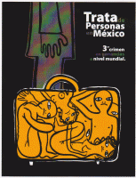
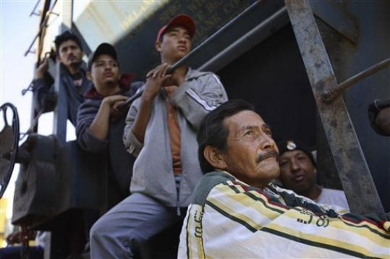
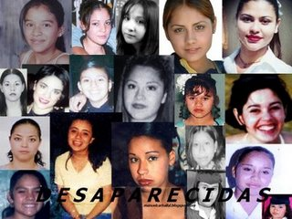
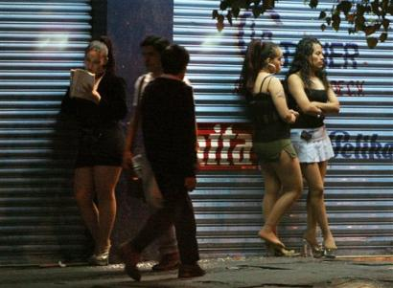
Trafficking in Mexico
Source, transit, and destination country
Tier 2
Federal anti-trafficking law (2007)
Issuing of regulation in February 2009
22 states and the DF had enacted legislation to criminalize some forms of trafficking
Notes:
Source:http://www.fbi.gov/news/stories/2006/june/humantrafficking_061206
How big is the problem? Very big. According to the State Department, up to two million people are trafficked worldwide every year, with an estimated 15,000 to 18,000 in the U.S., causing untold suffering.
How are victims “recruited”? Sometimes by force, but usually by fraud. Victims are lured away from family and friends by the promise of a better life, often in another country. For traffickers, there’s no shortage of victims—people eager for higher-paying jobs and other opportunities in distant cities and nations.
What kinds of work are victims forced to do? Both legal and illegal. Everything from prostitution to exotic dancing…from street peddling to housekeeping…from child care to construction and landscaping. Some victims are forced to work in restaurants and factories and are drawn into servile marriages and various criminal activities.
How are victims controlled? Many different ways: physically, through beatings, burnings, rapes, and starvation; emotionally, through isolation, psychological abuse, drug dependency, and threats against family members in home countries; and financially, through debt bondage and threat of deportation.
Escape is difficult because victims are often “invisible”—in the U.S., for example, victims typically don’t speak English; they’re afraid to approach authorities because they don’t want to be deported; and they have no idea where they are or how to get help.
What about the traffickers? In the U.S., they’re often members of the victim’s own ethnic or national community…are here legally and maintain close contact with their home country…may be fluent in English and a native language…and may have greater social or political status in their home country than their victims.

Slide 20
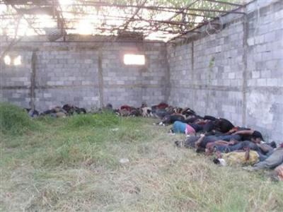
The Massacre of Tamaulipas

Slide 21
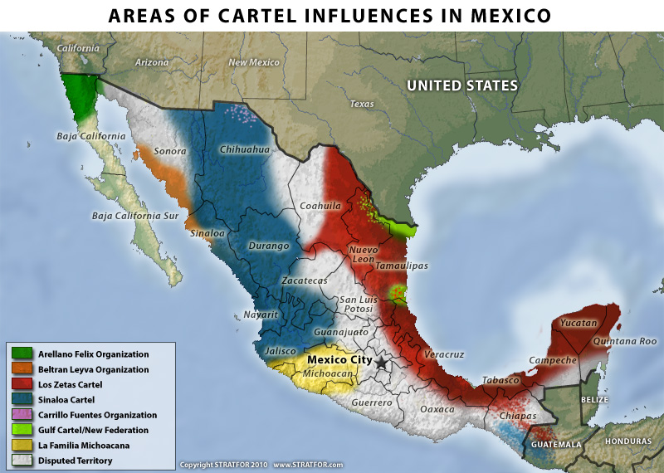
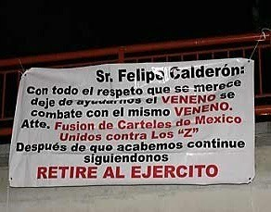
Los Zetas
One of the most powerful cartels operating in Mexico
Trying to extent its presence southward into Central America
“El Lazca” controls the organization
The New Federation – formed by El Golfo Cartel, Sinaloa Cartel and La Familia
Recruits minors and immigrants to increase its number of soldiers
Notes:
Source: http://www.stratfor.com/weekly/20091209_mexico_war_cartels_2009?fn=8616243288
STRATFOR
A military source in Tamaulipas said the Zetas, a brutal gang led by a former Mexican soldier named Heriberto Lazcano, known as "the Executioner," were behind the killings. Former special forces – Grupo anfibio de fuerzas especiales trained by CIA, escuela de las americas, israelia rmed forces
Fights between los Zetas and the gul cartel have resulted in an increase of violence. In addition, the gulf cartel and the sinaloa cartel and la familia have united to form the New federation against los Zetas.
PBS VIDEO and interview with journalist about the 72 migrants in tamaulipas: http://www.youtube.com/watch?v=wA7cy9RAMa0
Biggest since calderon’s war on drugs
Trans-migrants National human rights committee
9000 kidnappings in the past 6 months
Stateless people
Drug cartel violence: organized crime has taken control more and more of the smuggling of trafficking and humans
Business model of the drug traffickers expanding into other areas
Use the same routes and bribe the same officials
4 years since war on drug
Policy is not working when we see violence that continues to grow and also the power of the drug cartels
Spreading of violence – a symbol of success?
Lack of due process – insecurity
For Mexicans: regions where the security is a code red
Ordinary citizens are feeling this fight against organized crime
Corruption
78% of people don’t report the crimes
Organized crime has penetrated the different bodies of government
Changing the policy
Series of public dialogues to discuss the strategy
How to improve the strategy?
Open to a discussion about legalization
Most population against legalization
Source about kidnappings: http://www.lamnews.com/mexico_world_leader_with_6,000_kidnappings_a_year.htm
Most kidnap victims survive, but a growing number simply vanish, private investigator Max Morales said. He has worked on hundreds of kidnappings over the last 20 years, and says the crimes are increasingly going awry as petty thugs take up what was once the province of organized gangs.
The federal government could not provide nationwide figures on missing people, but the Mexico City Attorney General's office alone has posted more than 4,000 pictures of people reported missing in the capital in the past year who have not been found.
An estimated 6000 people are kidnapped per year (Source: nonprofit Citizens' Institute for Crime Studies)
In practical terms, many states including Tamaulipas and
Nuevo Leon have requested significant numbers of troops to augment the federal garrisons already
there, only to see their requests go unanswered because of the lack of available troops.
Business model of the drug traffickers expanding into other areas such as kidnappings, carjacking, extortion and human trafficking
Organized crime has taken control more and more of the smuggling of trafficking and humans
An estimated 6000 people are kidnapped per year
Migrants on route to the US fall pray to human rights abuses by drug gangs and even by law enforcement authorities
Traffickers use the same routes and bribe the same officials to traffic people as well as drugs

Slide 22
VIDEO: http://us.cnn.com/video/?/video/bestoftv/2009/08/16/lemon.michael.ware.intv.cnn
Notes:
VIDEO: (Start at 50)
Another revenue stream you diversify
Drug enforcement administration because the cartels are coming unner so much pressure in regards the drug business
People on the ground: flexing their muscles
HT multibillion $$ business
10 – 14 billion $ in drug

Slide 23
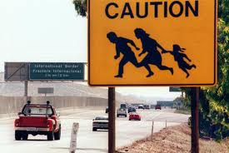
Vulnerable People
The power of drug gang increases
due to internal migration and high
unemployment rates
Rural to urban migration
Migrants will continue to cross Mexico in their efforts to reach the US or Canada
6 in 10 women/girls experience sexual violence
Limited options: to join the gangs, migrate to the US/Canada or continue a life of poverty and insecurity
Notes:
All irregular migrants are at risk of abuse, but women and children are especially vulnerable.
Criminals and corrupt public officials target women and children for trafficking and sexual assault.
As many as 6 in 10 women and girl migrants experience sexual violence during the journey.
Women migrants rarely report sexual violence and are very unlikely to file criminal complaints.
cerca de cuatro millones de mexicanos en ese país padecen pobreza y otros cinco millones carecen de seguridad social.

Slide 24
Analysis
Notes:
DO not go in depth
Use it as a conclusion and to go into recommendations

Slide 25
Policy Recommendations
Decriminalization of Marijuana
Education Program for prevention & Treatment
Drug Cartel Monopolization
Sustainable Organic Agriculture Reform

Slide 26
Works Sited:
http://mporioent.com/mpe/?p=4028
http://online.wsj.com/article/SB123518102536038463.html
http://online.wsj.com/article/SB10001424052748703960004575482080017955838.html
http://www.tni.org/article/failed-war-drugs-mexico
http://elpolvorin.over-blog.es/article-mexico-atrapado-entre-fuegos-narcos-ejercito-y-potencias-de-america-del-norte-59512936.html
nchr_index
HRW http://www.hrw.org/en/node/62433/section/2
http://www.fbi.gov/news/stories/2006/june/humantrafficking_061206
US State Department Traffic in Persons Report (2010)
http://www.ucl.ac.uk/spp/research/research-projects/nchr/nchr_index
http://us.cnn.com/video/?/video/bestoftv/2009/08/16/lemon.michael.ware.intv.cnn
http://www.stratfor.com/weekly/20091209_mexico_war_cartels_2009?fn=8616243288

